Slide 1



SPORTS BASICS
CRICKET INSIGHTS
Presented By: Anurag Mishra

Slide 2


ABOUT ME
I am an aspiring data analyst passionate about transforming IPL data into meaningful insights. Recently, I completed a Power BI project for Sports Basics, a growing sports blog, to support their IPL 2024 magazine. Using data from the last three IPL seasons (2021–2023), I delivered interactive dashboards and key findings to help fans, analysts, and teams better understand performance trends.

Slide 3

01
02
03
Company
Background
Problem
Statement
Goals To
Achieve
04
05
06
Data Set &
Tools
Sports
Terms
Dashboard
Requests
07
08
Key Insights
Recommendations

Slide 4
01
Sports Basics is a growing sports blog that recently entered the cricket analytics space. To attract more fans and boost website traffic, the company is launching a special edition magazine on IPL 2024. This edition will highlight exciting stats and insights from the last 3 IPL seasons, designed for fans, analysts, and teams.
COMPANY
BACKGROUND

Slide 5
02
Sports Basics wants to stand out in the IPL 2024 season by offering data-driven content that engages fans. To achieve this, the company aims to analyze team and player performance from the last three IPL seasons, delivering valuable insights to fans, analysts, and teams while boosting its digital presence.
PROBLEM
STATEMENT

Slide 6
03
The aim is to analyze IPL data from the last 3 seasons to uncover key insights for fans, analysts, and teams. By creating an engaging dashboard for Sports Basics, the goal is to present data-driven stories, highlight top performers, and support predictions for IPL 2024 in a fun and informative way.
GOALS TO
ACHIEVE

Slide 7
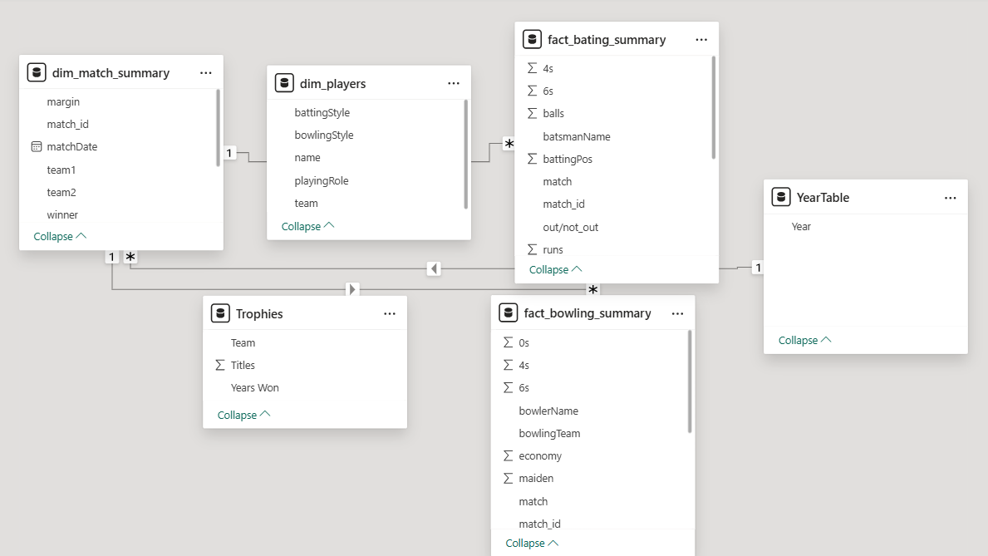
04
DATA SETS & TOOLS
💻
Data Sets
dim_match_summary
dim_players
fact_bating_summary
fact_bowling_summary
🛠️
Tools Used
Python for Primary &
Secondary Analysis
SQL & Excel For Insights
Mainly For Dashboards
POWER BI

Slide 8
🏏BATTING AVERAGE
🏏BATTING STRIKE
• Formula: Total Runs / Dismissals • Definition: Measures how many runs a batter scores on average before getting out.
• Formula: (Runs / Balls Faced) × 100 • Definition: Indicates how quickly a batter scores runs.
🏏BOWLING AVERAGE
🏏BOWLING ECONOMY
• Formula: Runs Conceded / Wickets Taken • Definition: Average number of runs given per wicket taken.
• Formula: Runs Conceded / Overs Bowled • Definition: Measures runs conceded per over by a bowler.
05
SPORTS
TERMS
🏏BOUNDARY %
🏏DOT BALL %
• Formula: (Fours + Sixes) / Balls Faced × 100 • Definition: Percentage of balls faced that result in boundaries.
• Formula: Dot Balls / Balls Bowled × 100 • Definition: Shows the percentage of deliveries with no runs conceded.
🏏WINNING %
• Formula: Matches Won / Matches Played × 100 • Definition: Win rate of a team across played matches.

Slide 9
06
DASHBOARD REQUESTS
01
Team Performance View: Analyze team-wise performance with metrics like Win %, Average Runs per Match, and Best Chasing Teams. View trends across seasons.
02
Player Performance View: Track player stats such as Batting Average, Strike Rate, Bowling Economy, and Wickets. Identify top-performing players.
03
Match Insights View: Get summaries of individual matches — including key players, turning points, and result breakdown (e.g., Win Margin).
04
Fan Engagement View: Highlight boundary %, sixes per match, and fan-favorite players based on performance trends and social mentions (hypothetical).
05
Executive Summary: A top-level dashboard summarizing team rankings, player highlights, and season-over-season trends for stakeholders (analysts, coaches, media).

Slide 10
07
KEY INSIGHTS
🗝️
Player Performance View
🗝️
Team Strategy View
Identify and invest in consistent top-performing players across batting and bowling metrics. Focus on players with high strike rates, economy rates, and consistency across seasons to drive team success.
Analyze winning patterns (e.g., chasing vs. defending success rates) to fine-tune match strategies. Prioritize venues and match conditions that historically favor the team's strengths.
🗝️
Fan Engagement View
🗝️
Operational Efficiency View
Leverage insights from player and team performance to drive fan engagement campaigns. Promote top-performing players and rivalries (e.g., head-to-head stats) to boost viewership and merchandise sales.
Utilize data from match outcomes, player workloads, and injury rates to optimize player rotation and reduce burnout. Integrate predictive analytics to support team selection and substitution decisions.
🗝️
Executive Summary View
Develop an overarching data-driven decision-making framework for team owners and analysts. Consolidate key insights into concise dashboards for strategic planning, sponsorship decisions, and long-term investments.

Slide 11

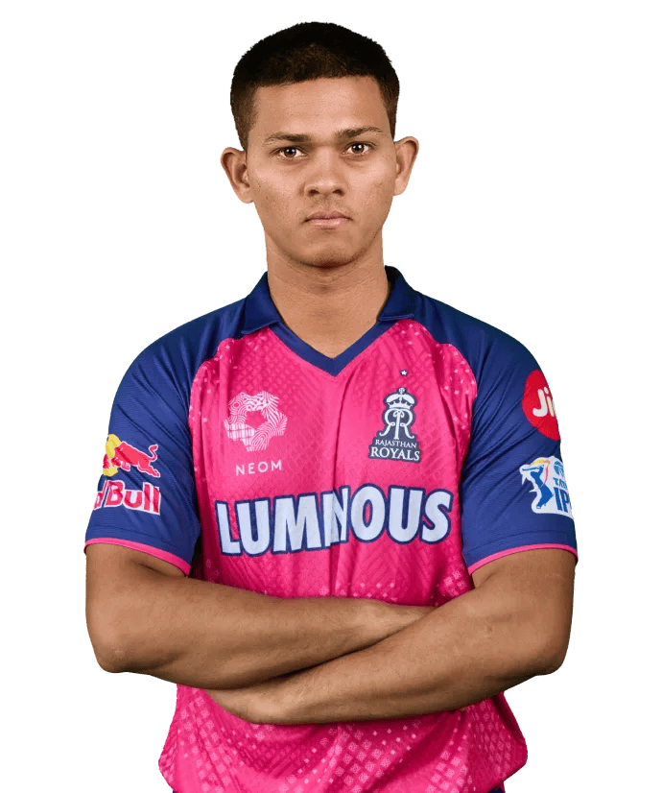
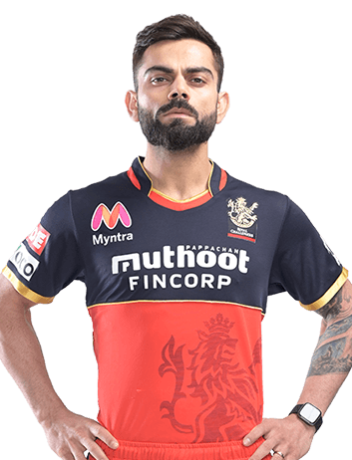


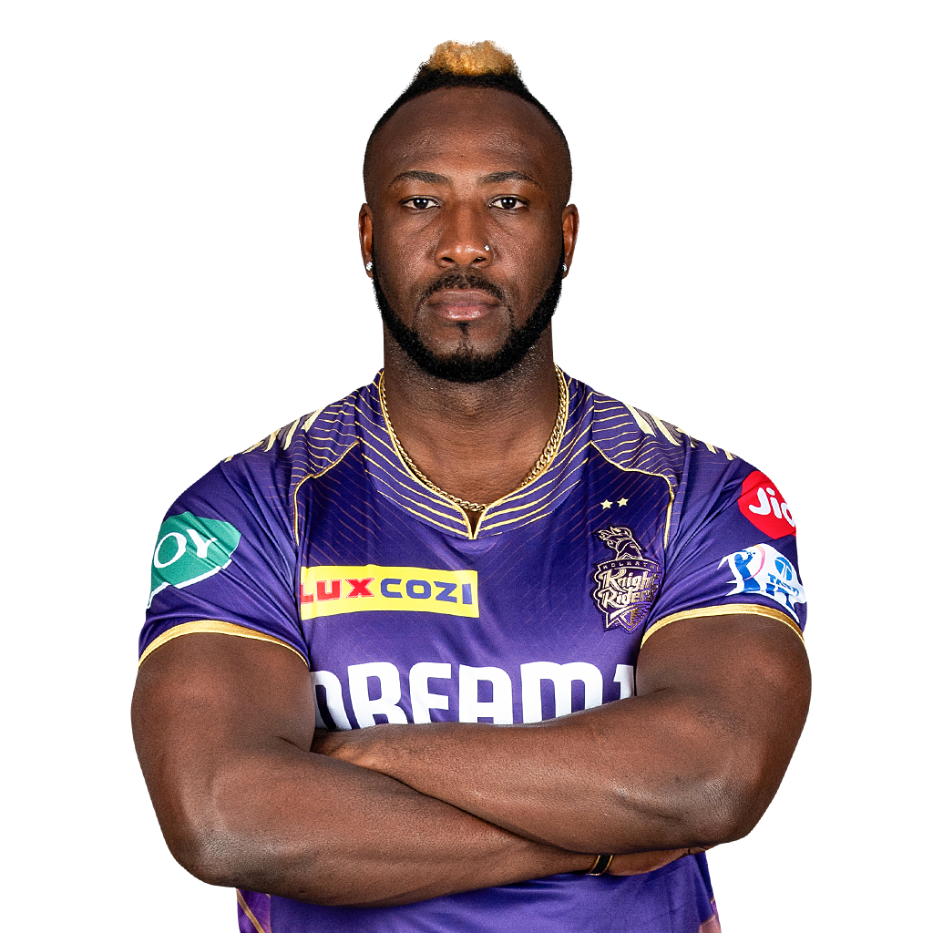
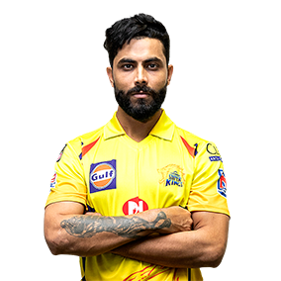

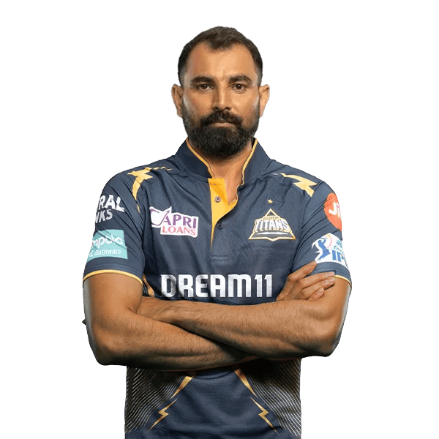

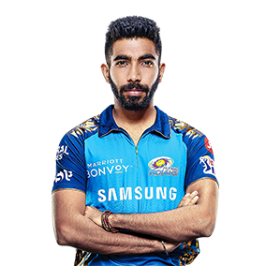
08
RECOMMENDATIONS
MY BEST PLAYING 11 FOR IPL 2024

Slide 12
THANKS CODE BASICS
Anurag Mishra

